Slide 1

Amazon sales analysis report Capstone Project

Slide 2

Analysing amazon sales data

Slide 3
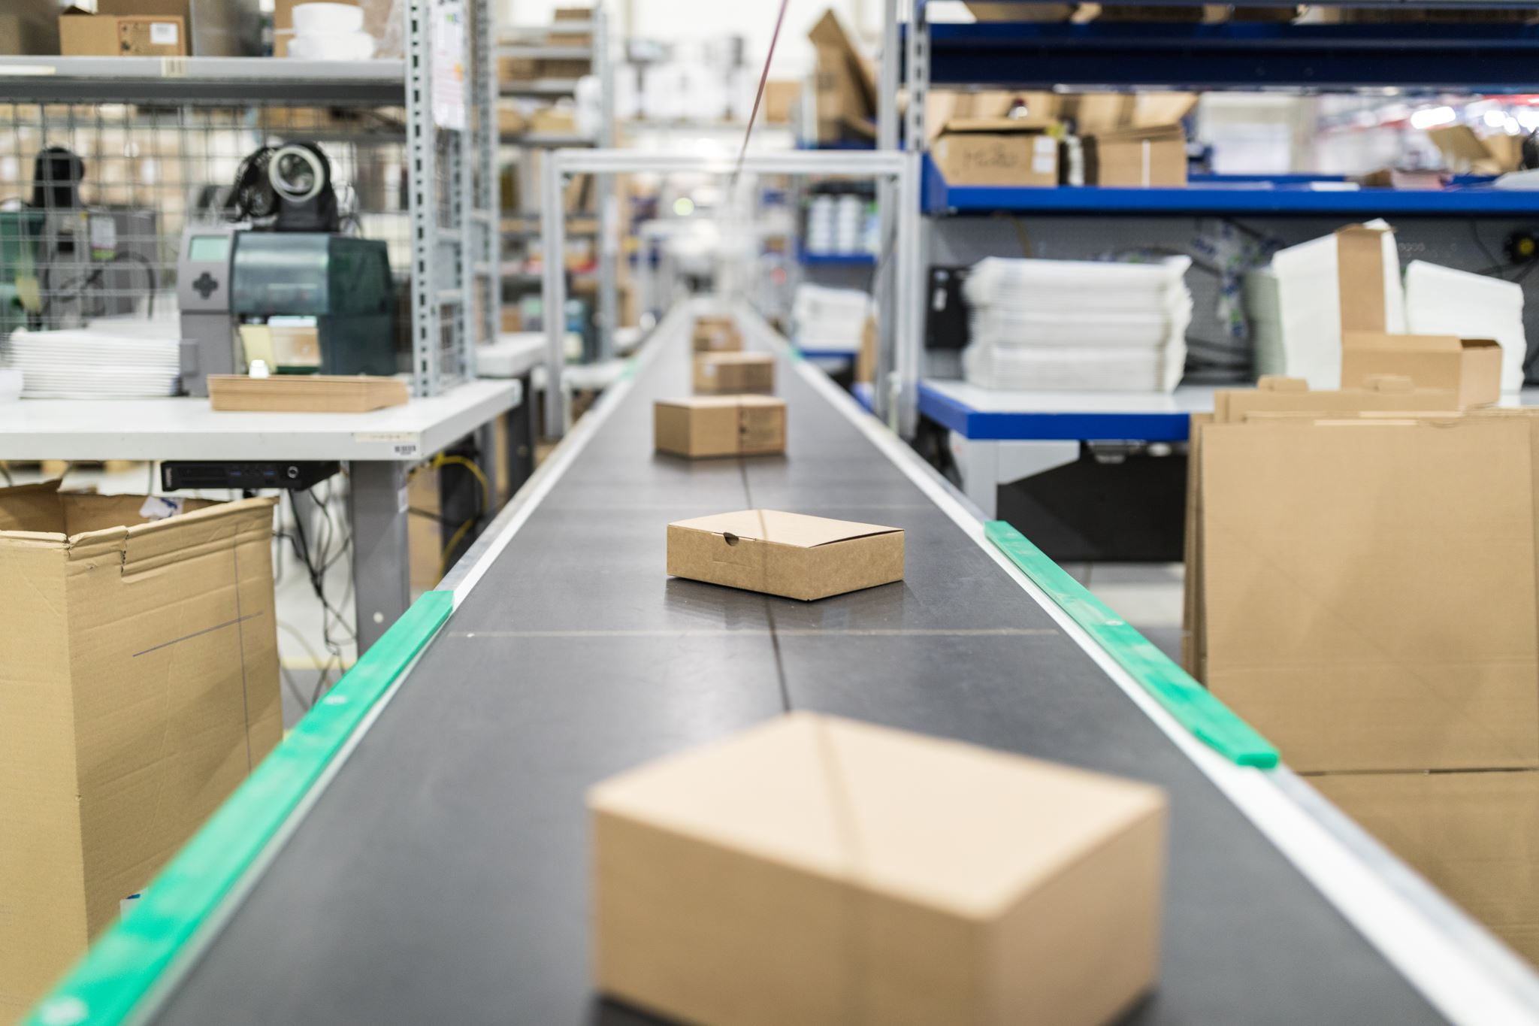
The major aim of this project is to gain insight into the sales data of Amazon to understand the different factors that affect sales of the different branches.
The goal of this project is to examine the amazon sales data in order to display top performing Branches, items , sales trends of various products and consumer behavior .

Slide 4

Analysis List
Product Analysis
Conduct analysis on the data to understand the different product lines, the products lines performing best and the product lines that need to be improved.
Sales Analysis
The result of this can help us measure the effectiveness of each sales strategy the business applies and what modifications are needed to gain more sales.
Customer Analysis
This analysis aims to uncover the different customer segments, purchase trends and the profitability of each customer segment.

Slide 5


Tools used for analysing data

Slide 6

Approach used
Data Wrangling: This is the first step where inspection of data is done to make sure NULL values and missing values are detected and data replacement methods are used to replace missing or NULL values.
1.1 Build a database
1.2 Create a table and insert the data.
1.3 Select columns with null values in them. There are no null values in our database
as in creating the tables, we set NOT NULL for each field, hence null values are filtered out.

Slide 7

Approach used
Feature Engineering:
This will help us generate some new columns from existing ones.
Add a new column named time_of_day to give insight of sales in the Morning, Afternoon and Evening. This will help answer the question on which part of the day most sales are made.
Add a new column named day_name that contains the extracted days of the week on which the given transaction took place (Mon, Tue, Wed, Thur, Fri). This will help answer the question on which week of the day each branch is busiest.
Add a new column named month_name that contains the extracted months of the year on which the given transaction took place (Jan, Feb, Mar). Help determine which month of the year has the most sales and profit.

Slide 8
THE 3 DISTINCT CITIES IN MYANAMER
Three different branches of Amazon, respectively located in
Mandalay, Yangon and Naypyitaw
Branches and its corresponding cities
A
B
C
Yangon
Mandalay
NayPyiTaw

Slide 9
THE COUNT OF DISTINCT PRODUCT LINES IN DATASET
1.Electronic accessories
2.Fashion accessories
3.Food and beverages
4.Health and beauty
5.Home and lifestyle
6.Sports and travel

Slide 10
Product line has the highest sales?
- FOOD & BEVERAGES
Payment method occurs most frequently?
- E-Wallet
In the month of JANUARY Cost of goods sold (cogs) reached it peak with the sum of 110754
Which product line generated the highest revenue?
Food and beverages 56144.96

Slide 11
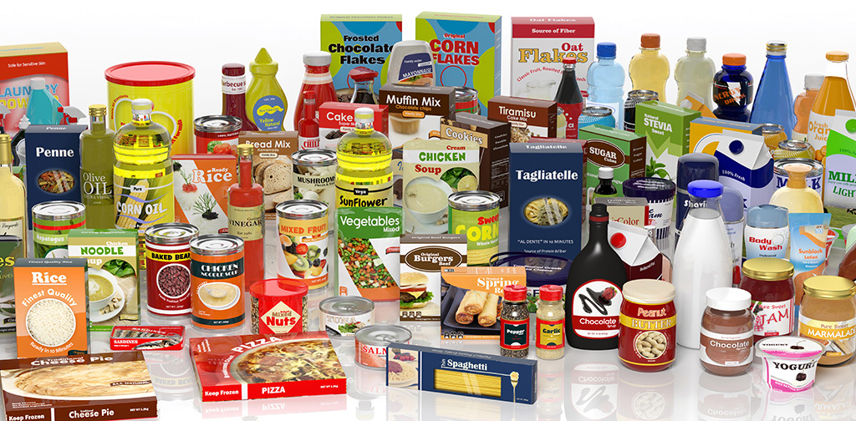

The Product line
– FOOD & BEVERAGES generated the highest revenue among all the items in the 1st quarter of the year 2019 with the REVENUE of 56144
The city with the highest revenue recorded for the 1st quarter of the year 2019 among the 3 cities is :
- NAY PYI TAW

Slide 12


* The product line, Fashion Accessories most frequently associated with the gender – FEMALE
* The product line, Health & Beauty associated most frequently associated with the gender – MALE

Slide 13
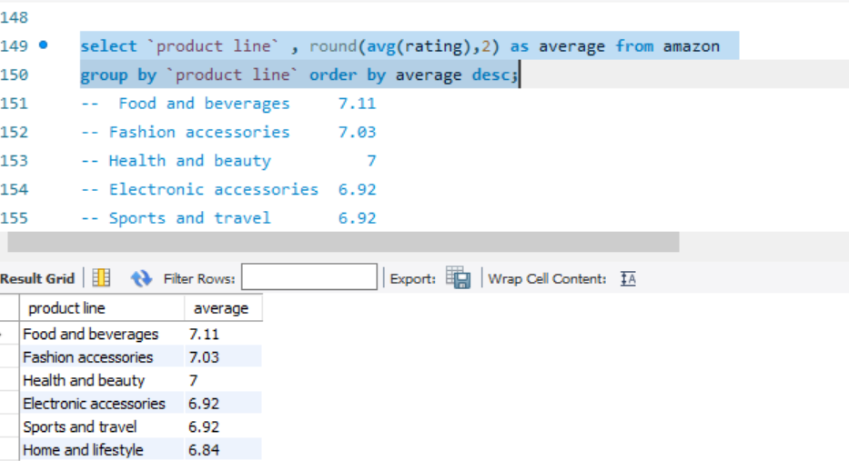
The average ratings for each product line :

Slide 14
The customer type contributing the highest revenue :
* Members contributing with count of 501 with total amount of 164223.
* Normal customers contributing with count of 499 with the amount of 158743.

Slide 15

The city with highest VAT percentage is :
NAHPYITAW
The customer type with the highest VAT payments are customers with exclusive membership with the VAT contribution of 7820.

Slide 16

The count of distinct customer types in the dataset is : 2
The count of distinct payment methods in the dataset is : 3
The customer type occurs most frequently is : Membership holders
The customer type with the highest purchase frequency is : Membership holders with the total amount of 164223

Slide 17

Sales Performance Report
1. Addressing Low Performing Product Lines:
The Home & Lifestyle product line is currently experiencing the lowest sales. To address this, we need to implement enhanced marketing strategies and raise awareness about these products. This could involve targeted advertising campaigns, collaborating with influencers, and showcasing the unique features of these products to attract more customers.
2. Revenue Analysis for Q1 2019:
In the first quarter of 2019, February recorded lower revenue compared to the other two months. This dip in sales during February requires further investigation to identify any underlying causes such as seasonal trends, competitor actions, or internal factors affecting consumer behavior.
3. Revenue Distribution Across Product Lines:
Among the product lines, Food & Beverages generated the highest revenue in Q1 2019, whereas sales for Health & Beauty products were comparatively low. This suggests a potential opportunity for improvement in marketing and promotion strategies for Health & Beauty products to boost sales.

Slide 18

4. Targeting Low Revenue Cities:
Naypyitaw, the capital city of Myanmar, recorded the highest revenue. To replicate this success in other cities, we need to implement new marketing strategies such as offering discounts, cashback incentives, and faster delivery options to attract more customers and increase sales in those areas.
5. Addressing Negative Feedback:
There is a concerning trend of receiving more negative remarks than positive ones for our product lines. This requires urgent attention. We should focus on improving both product quality and service standards to enhance customer satisfaction and loyalty.
6. Customer Engagement Strategies:
Membership customers exhibit a higher purchase rate, indicating the effectiveness of premium offers in driving sales. We should extend similar offers to regular customers to incentivize them to join the membership program, thereby increasing customer retention and overall sales.

